Slide 1

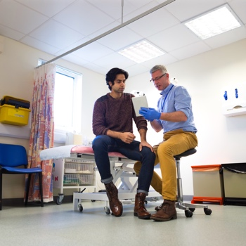


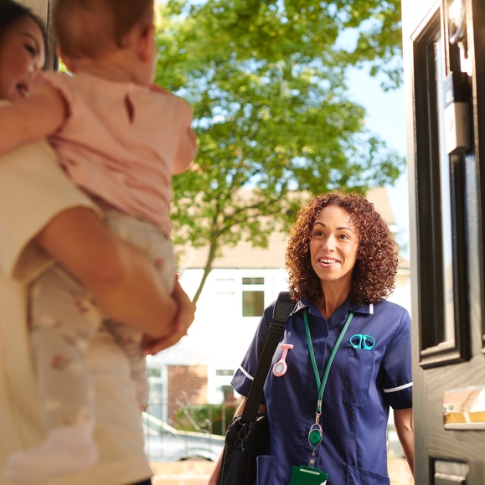
Primary Care Access Bulletin:
Central Bedfordshire
November 2022
Welcome
Welcome to the first Primary Care Access bulletin, which aims to share current information about GP practices to staff and patients alike in each local area. Future editions will include any planned changes to help inform local people about what improvements are being made.

Slide 2

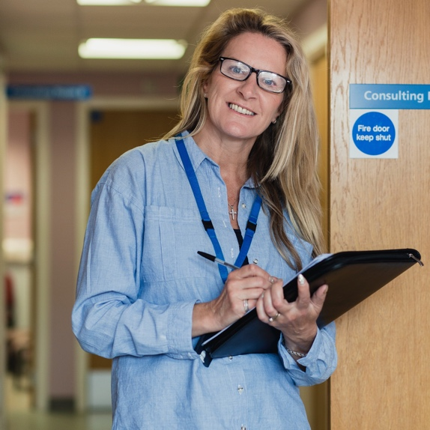
Accessing your General Practice team
GP practices have remained open throughout the Covid-19 pandemic but have had to adapt to very different ways of working to ensure the safety of patients and staff. Some of these new ways of working, which include the use of telephone and video calls, are being retained as these are viewed as helpful by many local people and healthcare professionals. But practices have also returned to seeing people face-to-face, just as it was before the pandemic.
Working in this hybrid way allows practice teams to ensure we provide personalised care to our residents and ensure we can respond to rising demand for services.
This bulletin is designed to help you understand how you can access your local surgery team, the different methods you can use, and the different services you might need. Not every service and discipline is available in every practice – this bulletin is intended to be used as a guide alongside the information available locally from your practice and/or Primary Care Network.

Slide 3

Can patients still see GPs face-to-face?
Face-to-face appointments with the practice teams in Central Bedfordshire remain a consistent method of consultation – where indicated by clinical need. Based on national figures, our practices collectively provide some of the highest percentage of face-to-face appointments across England.
Central Bedfordshire
Indicator | Activity – month of October 2022 | Activity – month of October 2021
Total appointments offered by practices | 161,440 | 157,169
Appointments that were with a professional other than a GP | 56% | 54%
% of total appointments that were face to face | 85% | 80%

Slide 4





Can patients still see GPs face-to-face? continued
Importantly telephone or video consultation will continue to be offered as a clinically safe option where this is the right thing to do, as they reduce travel burden for patients and minimise risk of infections such as Covid-19 and flu being spread to other people. Face-to-face appointments with GPs and other clinical members of the practice team take place where there is an identified need. This may be clinical when a patient needs to be seen in person to assess their condition or non-clinical, for example a patient is unable to use a telephone or digital systems to speak with the practice.
Most practices will call all patients first and offer face-to-face appointments based on these discussions. This allows practice staff to triage patients based on clinical need, allowing clinicians to work more efficiently and increase capacity to support more people. Practice teams are asking their registered population to be patient with this ‘new system’ and to be assured that those needing to be seen in person will get offered a face-to-face appointment if and when needed.
What is total triage?
All surgeries altered their ways of working because of the pandemic to run a ‘total triage’ model or ‘talk before you walk’, enabling patients to be directed to the most appropriate service including:
telephone
e-mail or video consultations
referrals to external services
or if clinically appropriate,
a face-to-face appointment.
Patients contacting their GP practice are asked to provide information to the practice reception team about the reasons for their contact.

Slide 5

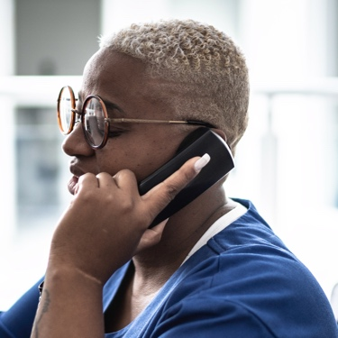
Why do reception staff ask such personal questions when I call?
We ask all patients to give reception staff as much information as they can, so they may be directed to the right person in a timely way.
Most of our GP surgeries operate a triage system, which is supported by a dedicated, trained team of individuals – including receptionists; who have received specific training to support triage. All reception staff, as part of the practice’s triage system, work under a strict confidentiality contract.
The information patients give the receptionist allows the clinical team to make an informed decision on the most appropriate option to provide. This may be a call from a GP or other member of the practice team, or an appointment to visit the practice or another part of the health service, such as a pharmacy.
There are many different clinical staff that work in GP surgeries and the questions that the triage team ask helps to make sure you are directed to the most appropriate clinical staff member to assist you. All members of the practice team are highly trained, and practices now take a multidisciplinary approach to patient care to ensure people are seen by the right person at the right time. This may not always be a GP, and in many cases will not need to be. For example, pharmacists can deal with medication queries/repeat prescription issues and medication reviews just as effectively as a GP. This allows GPs to focus on clinical matters and unwell patients.

Slide 6







Why am I offered appointments with clinical professionals other than my GP?
To respond to the increasing demand for
health care services, the size and diversity of primary care team members has increased, and additional practitioners have joined our primary care workforce, including:
Nurse practitioners
Pharmacists
Mental health practitioners for adults and children
Social prescribers and health coaches
Paramedics
In addition, primary care teams are working more closely with colleagues from local hospitals, the local authority, voluntary organisations, and community groups including sharing office space/facilities.
This approach ensures primary care teams can offer more rounded and holistic care and reduce ‘hand-overs’ to other agencies.

Slide 7



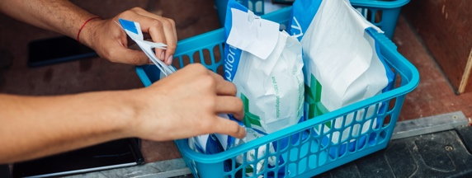
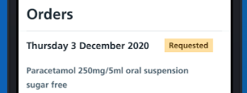
How can you help general practice?
Self-care or use pharmacy services as a first step when you feel unwell.
Be patient, be polite
and be kind – our staff
are working as hard as they can.
Did You Know:
Repeat prescription requests can be managed through their surgery website or via the
NHS App.
Patients can also register for an online account with their practice to order medication, view their patient record or see test results using the practice website or NHS App.

Slide 8







What to do if you are unwell & need to be seen today for a non-emergency!
What to do if you are unwell
Need to be seen today for a non-emergency?
Think GP First
NHS 111
Call your GP practice between 8am - 6pm Monday - Friday
Contact NHS111 online
or call NHS 111 between
6pm - 8am and at the weekends
if you have an urgent same day health need where you will be signposted to
a service close to where you live.
Need to be seen today for an emergency?
Minor injury
ED or
call NHS 111
Call 999
Strains, cuts, sprains and
burns can all be treated at our Urgent Treatment Centres at Bedford Hospital, Putnoe Walk-in Centre, Luton UTC at Town Centre GP Surgery or Milton Keynes UCC at Milton Keynes Hospital.
Call 999 straightaway
for chest pains, choking,
severe blood loss, blacking
out, unconsciousness,
suspected stroke or serious injury.
Alternatively you may be able to help yourself
Help Yourself
Pharmacy
For hangovers, grazed knees,
coughs and sore throats visit www.nhs.uk also download the
free Child Health app.
For diarrhoea, runny nose,
painful cough and headaches
visit your local pharmacy for free advice and to buy medication.
NHS 111 BSL service for Deaf patients www.interpreternow.co.uk/nhs111 999 texting service for Deaf patients - you MUST register first. Text ‘Register’ to 999 & follow instructions. In emergency text ‘Ambulance’ & address. Find out more at www.emergencysms.org.uk
Notes:
s

